Slide 1
Presentation of Models
Adam Canton

Slide 2
Some overview things
In following code I went through the EDA both ways once where I did collinearity checks first and then paired the data down to 179 Obs of 14 variables (Second Pass EDA.Rmd)
The second way (I called it backward) I did the same cleaning and inputting values but jumped right to variable selection on 183 obs of 20 variables (Going Backward.Rmd)
It turned out that the selection methods got rid of one of the highly correlated pairs nearly every time.
I think the last step to deciding between these and what ever models y’all have is going to be the test set runs of the models. I’m not entirely sure how to code for that – but I’m hoping these give us everything we need to do that.
As we already talked about, there are some oddities in which countries are considered developing vs developed, some standouts:
Developing: France, Canada, Israel, South Korea, a few others
Variables with high collinearity
GDP and Percentage Expenditure (0.96)
Infant Deaths and Deaths under 5 (1)
Thinness categories (0.95)
Schooling and income comp (0.91)
Found values
27 GDP values from World Bank
41 Population data also from World Bank
27 Percent expenditures – they weren’t NA’s but just 0’s – World Bank
Almost 20% of the data set is 0 here without inputting
10 Schooling Values - United Nations Development Program and Unesco Data

Slide 3
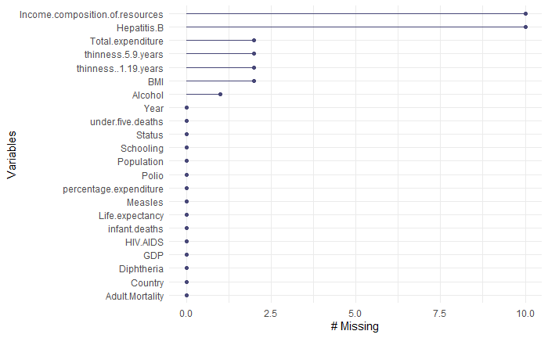
Data Cleaning and added in values
This is the missing data we have left. I ran the analysis with no NAs and with them. In nearly every run the model that contained the NAs did better in terms RMSE and other metrics.

Slide 4
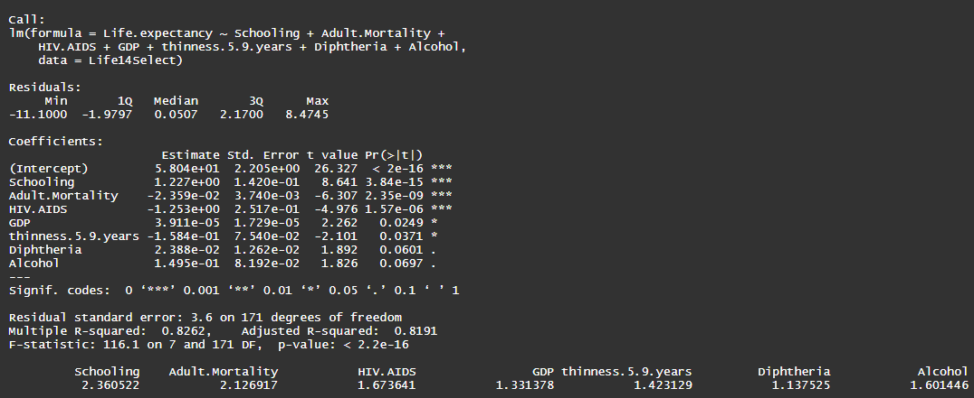
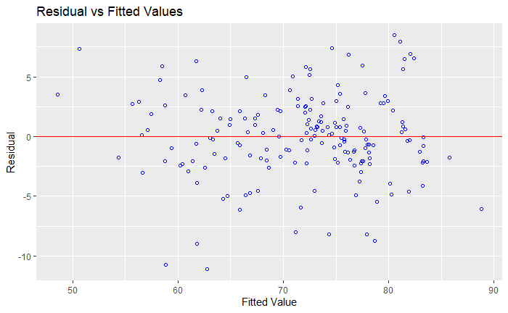
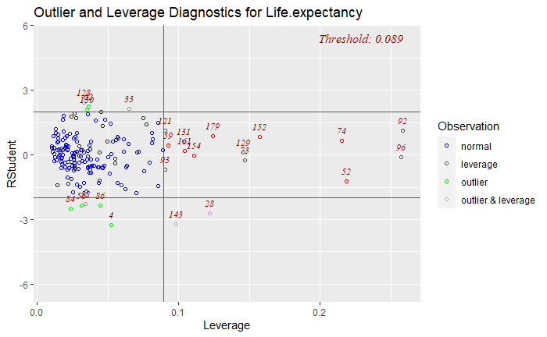
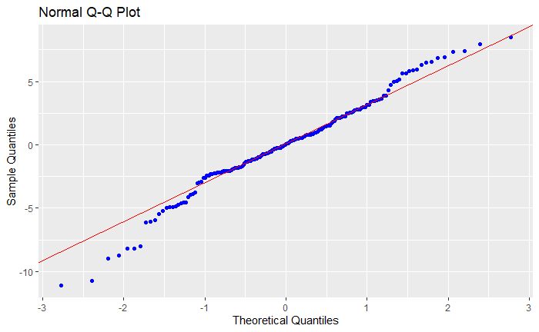
Model 1
Threw out some variables and narrowed down to 14.
OLS Step Both is a combination forward-backward-stepwise selection method.
I chose to look at p-values because they also included RMSE and AIC in the metrics
Fit metrics look good. A bit of left skew in the QQ plot – but as Grace already ran a logged version and found it worse I think were stuck here – maybe try square root if we get desperate
Some predictors not significant but removing predictors starts increasing RSE and makes skew worse – look at model 2 in this Rmd to see

Slide 5
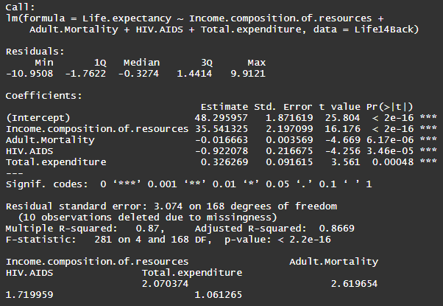
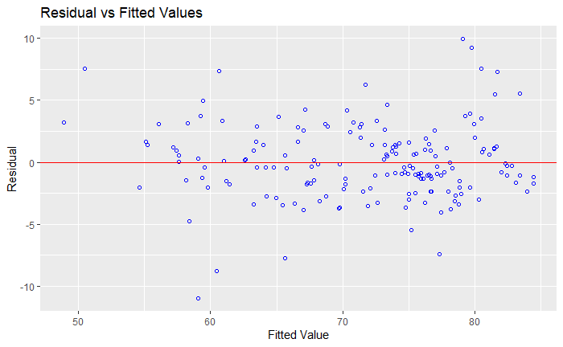
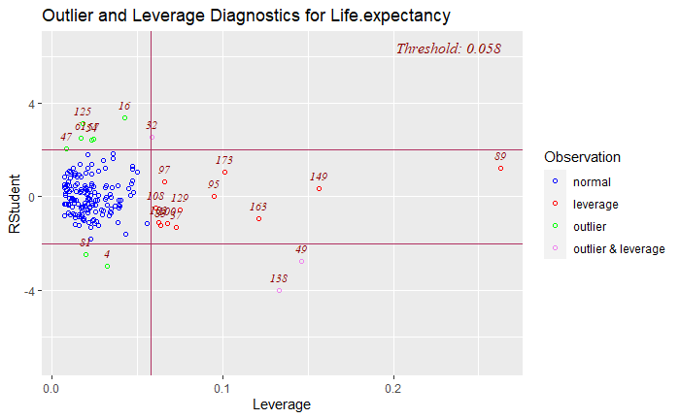
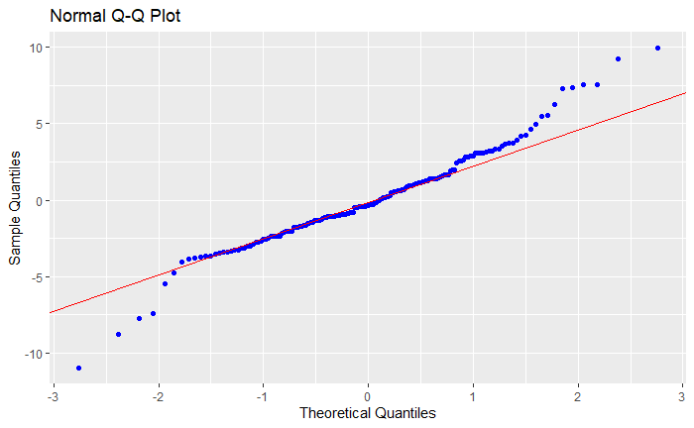
Model 3 – Going Backwards I
Much more efficient model here – only 4 predictors.
Fit metrics look just as good if not better than model 1 (and 2)
Lower RSE better R²
This is where I was looking into whether we should include the NA’s or getting rid of them
Life14Back2 has NA’s dropped but performed worse pretty much everytime
Also experimented with excluding the columns with NA’s (HepB and Income Comp) but these also performed poorly in comparison
Skip down to the model tests if you want to just get to fit metrics

Slide 6
Comments on other models and selection methods
Outliers
Strangely enough both of the selection first models have only two outliers and they aren’t the same ones.
Modeltest3 – Outliers: 138 – Samoa and 49 – Dominican Republic
Modeltest4 – Outliers: 143 – Seychelle and 28 – Ivory Coast
I could not find anything particularly interesting about either of these sets, though both Dominican Republic and Samoa would be American Territories.
I can run these models again with them excluded – but the cooks d plots of both are relatively tame - open to suggestions though.
Open to suggestions on any of it really.
There are several other models and adjustments I made to check some things out
The Second Pass EDA.Rmd is much better commented than the Going Backward
Most of the commenting applies to both
Going Backwards is nearly all model runs
I did experiment with other selection methods (just forward and backward etc) I did not see anything of interest over what I already had. If that is something we think needs more investigation its some easy code changes
The olsrr package has some interesting selection/combinations methods
Ols_best_subset
Ols_all_subset – this one will take a while with 20 variables

